Slide 1


Google Developer Student Club
DSA
BOOTCAMP
CONDUCTED By GDSC ICOER

Slide 2
STACK
Presentation By Nikita Choudhari

Slide 3

Definition of Stack Data Structure
Stack is a fundamental data structure that follows the Last In, First Out (LIFO) principle, which means that the last element added to the stack will be the first one to be removed.
It is similar to a stack of books placed in a box, where we can only add or remove the topmost book.

Slide 4

Importance of Stack Data Structure
1
Efficient Memory Allocation
2
Algorithm Implementation
3
Undo/Redo Functionality
Enables efficient memory allocation in programming languages, making it easier to manage function calls and local variables.
Serves as a fundamental building block for various algorithms, including parsing and expression evaluation.
Essential for implementing undo/redo functionality in applications, enabling users to reverse and replay actions.

Slide 5
Basic Operations of Stack
Pop
Push
Adds an element to the top of the stack.
Removes and returns the top element from the stack.
Peek
isEmpty
isFull
Returns the top element without removing it from the stack.
Checks if the stack is empty or not.
Checks if the stack is full or not.

Slide 6
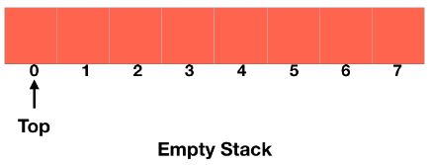
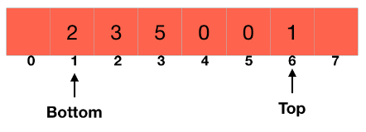
Implementation of Stack using Array
A stack can be implemented using an array, where elements are stored continuously in memory.
We need to add and remove elements from the top of the stack, we are going to use a pointer which is always going to point the topmost element of the stack.
It will point to the element at index 0 when the stack is empty.

Slide 7
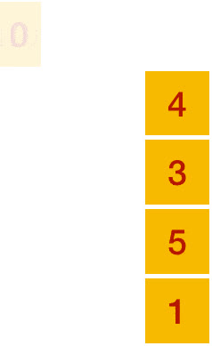
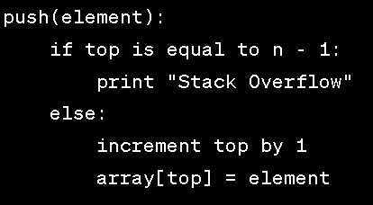
PUSH

Slide 8
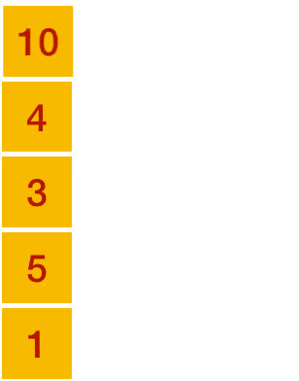
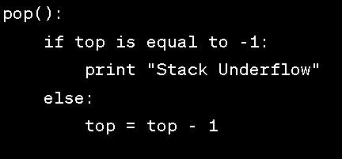
POP

Slide 9
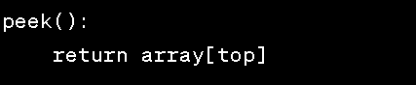
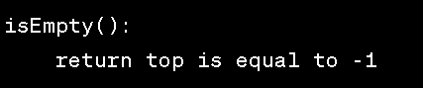
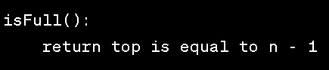
Peek
isEmpty
isFull

Slide 10
Algorithm
Initialize an array of size n
Initialize top = -1
push(element):
if top is equal to n - 1:
print "Stack Overflow"
else:
increment top by 1
array[top] = element
pop():
if top is equal to -1:
print "Stack Underflow"
else:
top = top - 1
peek():
return array[top]
isEmpty():
return top is equal to -1
isFull():
return top is equal to n - 1

Slide 11


Slide 12
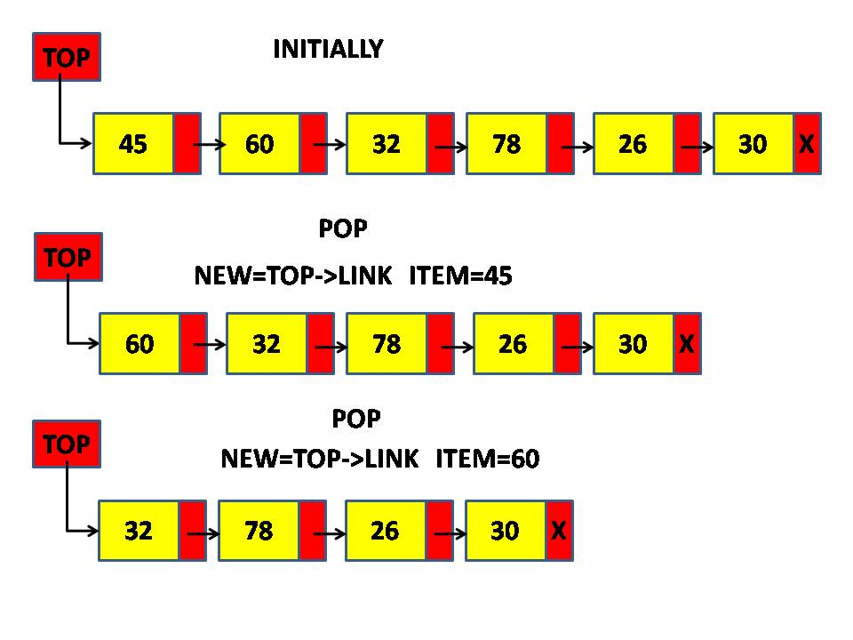
Implementation of Stack using Linked List
A stack can be implemented using linked list also, where elements are stored using nodes in memory.
Implementing a stack using a linked list involves creating a linked list structure where each element of the stack is represented as a node.
The top of the stack is represented by the head of the linked list.

Slide 13
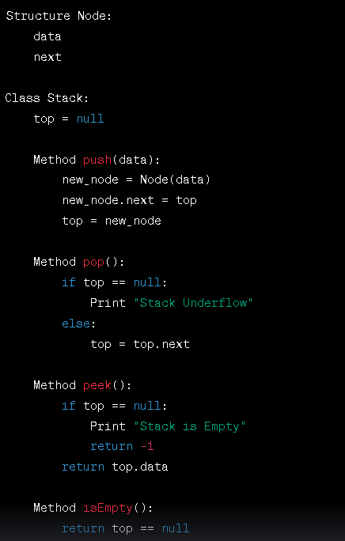
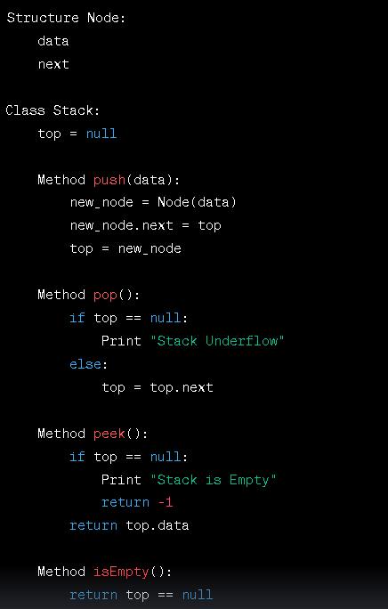
Algorithm

Slide 14
Common Problems and Challenges in Stack Data Structure
1
Stack Overflow
It occurs when the stack exceeds its predefined size, leading to memory allocation issues.
2
Stack Underflow
It occurs when an attempt is made to pop an element from an empty stack, causing an underflow error.

Slide 15
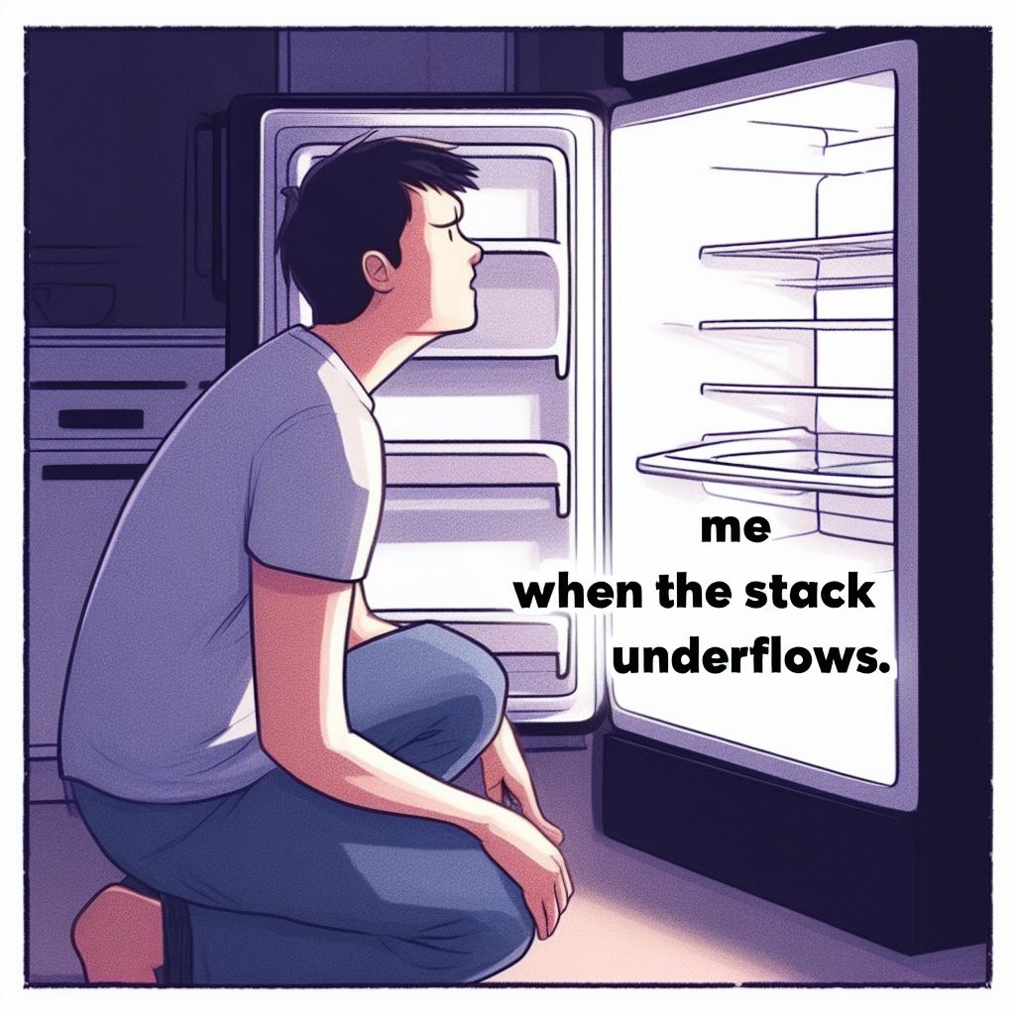


Slide 16
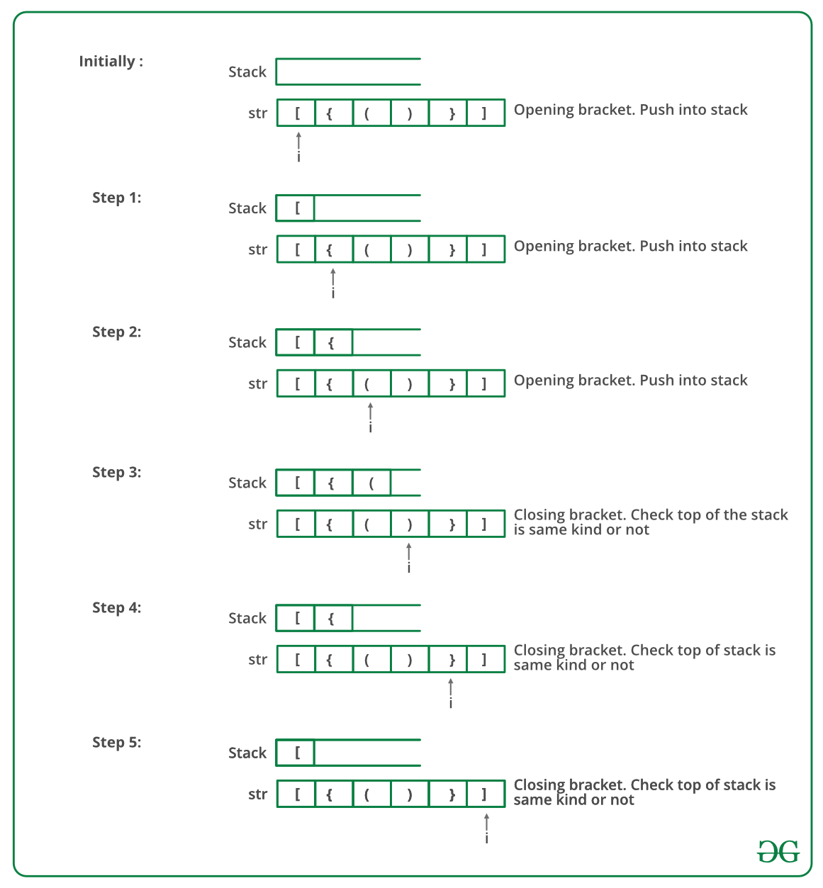
Check for balanced Parenthesis

Slide 17
Check for balanced Parenthesis

Slide 18
Applications of Stack
Stacks enable the efficient management of function calls, keeping track of the order of execution and memory allocation.
Stacks are essential for evaluating mathematical expressions, including infix, postfix, and prefix notation.
Function Call Stack
Expression Evaluation
Stack can be used to implement undo/redo functionalities that allow users to revert and redo actions.
Stack are helpful in backtracking algorithm
Undo/Redo Functionality
Backtracking
Algorithm

Slide 19
Conclusion
Stacks are a fundamental data structure that follows the Last In, First Out (LIFO) principle.
They are used in various computer science applications, such as function call management, expression evaluation, and parsing.
Common stack operations include push, pop, peek, isEmpty, and isFull, enabling efficient data handling.
Implementations of stacks can utilize arrays or linked lists, each with its own benefits and considerations.
Mastery of the stack concept is crucial as it serves as the foundation for understanding more complex data structures and algorithms.

Slide 20

Thank You
We hope you found this presentation on stack data structures informative and helpful. If you have any further questions or would like to learn more, feel free to ask. Thank you for your time and attention!

